Slide 1
Electric Potential

Slide 2

Electric Potential Difference
The Electric Potential Difference is equal to the Work required to move a charge through an electric field divided by the magnitude of the charge.
Electric Potential is a measure of work done per unit of charge.
SI Units: joule/coulomb = Volt (V)
$∆V=VB−V_{A}=\frac{∆EPE}{q_{o}}=\frac{−W}{qo}$

Slide 3
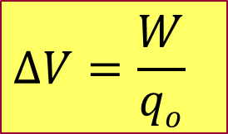
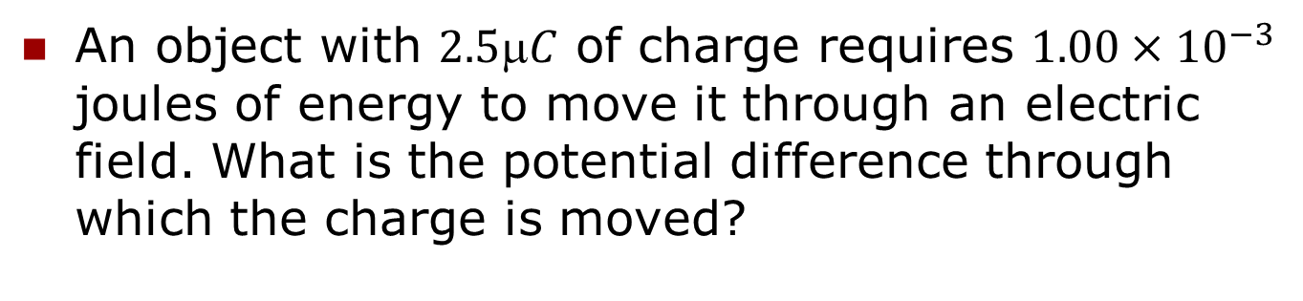

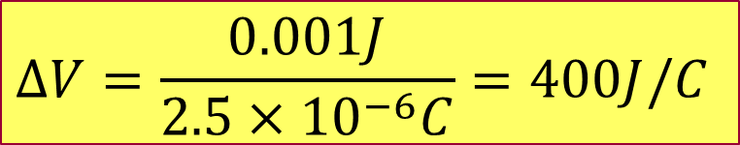
Example 3: Electric Potential
An object with $2.5C$ of charge requires $1.00×{10}^{−3}$ joules of energy to move it through an electric field. What is the potential difference through which the charge is moved?
$$∆V=\frac{W}{qo}$$
$$∆V=\frac{0.001J}{2.5×{10}^{−6}C}=400J/C$$
$$∆V=400V$$

Slide 4
Electric Potential Difference (Point Charges)
To find the potential difference between two points in an electric field, we need to know the difference in electric potential energy at those two points in the field.
$∆V=VB−V_{A}=\frac{∆EPE}{q_{o}}=\frac{−W}{qo}$
Point Charges only

Slide 5

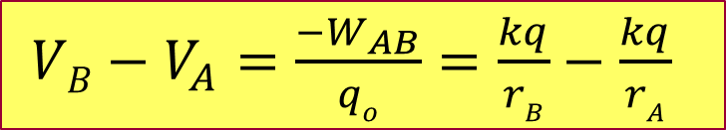
Relationship Between Electric Potential and Distance(point charges)
Consider relationship between V and r.
$VB−V_{A}=\frac{{−W}_{AB}}{qo}=\frac{kq}{rB}−\frac{kq}{rA}$
What happens to V as r_{B} goes to ∞?
  As r increases, i.e., as r_{B} → ∞, V → 0.
  The relationship above reduces to:
The sign of the charge will determine if the electric potential is positive or negative.
When two or more charges are present, the total electric potential is the sum total from all the charges present in the system.
$$V=kq/r$$

Slide 6
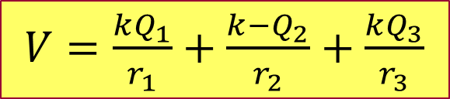
Electric Potential(point charges)
P
P
Consider the following system of three point charges. What is the electric potential that these charges give rise to at some arbitrary point P?
Use the law of superposition to determine V.
Note that the electric potential
can be determined from any
arbitrary point in space.
$V=\frac{kQ_{1}}{r_{1}}+\frac{k{−Q}_{2}}{r_{2}}+\frac{kQ_{3}}{r_{3}}$
Q₁
Q₂
+
-
r₁
r₂
Q₃
+
r₃
P
P

Slide 7

Electric Potential and Electrical Potential Energy/Work (point charges)
If we now move a test charge from infinity to point P, we can determine the potential energy of the system or the work required to it to its new location.
Remember: work = energy.
$$EPE=−W=q_{°}V$$
$$−W=q_{°}\left(\frac{kQ_{1}}{r_{1}}−\frac{kQ_{2}}{r_{2}}+\frac{kQ_{3}}{r_{3}}\right)$$
$$−W=q_{°k}\left(\frac{Q_{1}}{r_{1}}−\frac{Q_{2}}{r_{2}}+\frac{Q_{3}}{r_{3}}\right)$$
Q₁
Q₂
+
-
r₁
r₂
Q₃
+
r₃
q_{o}
q_{o}
P
+

Slide 8
Example 4: Two Point Charges
Two point charges, +3.00 µC and -6.10 µC, are separated by 1.00 m. What is the electric potential midway between them?
-6.10 μC
+3.00 μC
A
B
0.5 m
0.5 m
V_{total} = V_{A} + V_{B} = kq_{A}/r_{A} + kq_{B}/r_{B}
V_{A} = (8.99 x 10⁹ Nm²/C²)(-6.10 x 10⁻⁶C) = -109678 V
0.5m
V_{B} = (8.99 x 10⁹ Nm²/C²)(3.00 x 10⁻⁶C) = 53,940 V
0.5m
V_{total} = -55700 V

